Slide 1

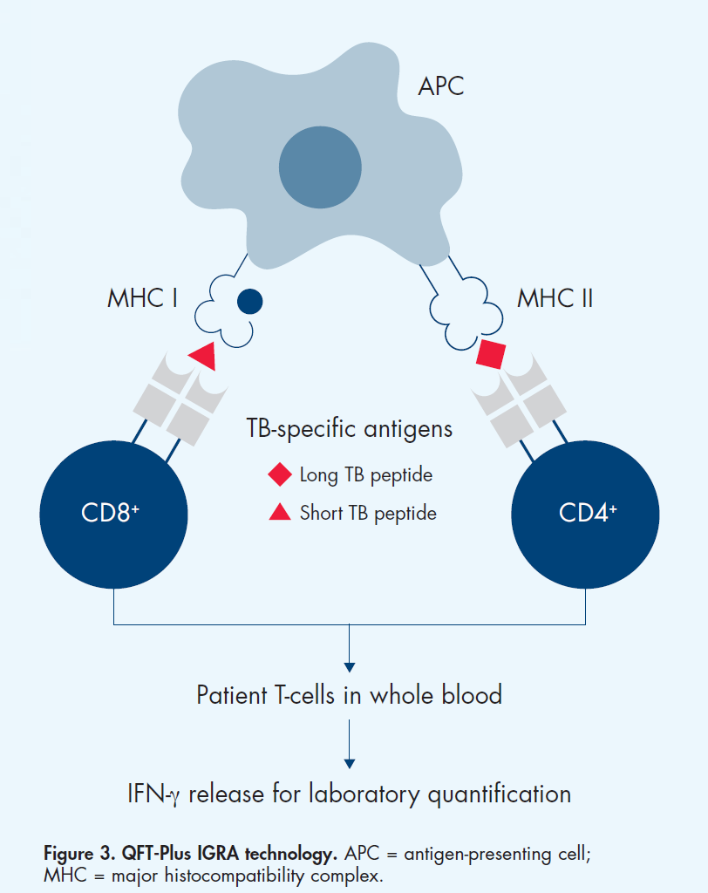
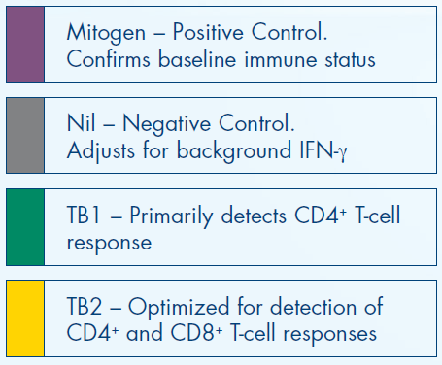
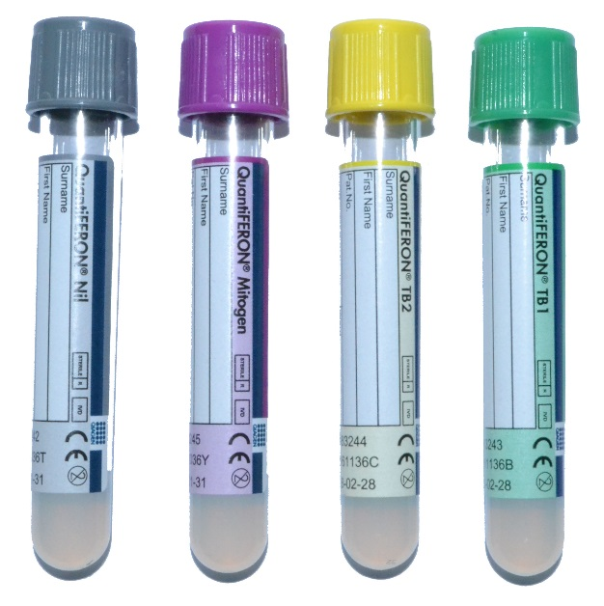

Comparison of 3 immunodiagnostic tests for Latent Tuberculosis infection among Thai prisoners
Abstract # PEB0123
Contact:
Dr. Sasiwimol Ubolyam
HIV-NAT, Thai Red Cross AIDS Research Centre, 104 Ratchdamri Rd., Pathumwan, Bangkok, Thailand 10330
Emaill: sasiwimol.u@hivnat.org
Sasiwimol Ubolyam¹, Thatri Iampornsin¹, Tanyathip Jaimulwong¹, Khuanruan Supakawee¹, Jiratchaya Sophonphan¹, Weerakit Harnpariphan², Ruamthip Supanun², Apicha Mahanontharit¹,
Sivaporn Gatechumpol^{1,3}, Kamon Kawkitinarong³, Kiat Ruxrungtham¹, Praphan Phanuphak¹, Anthony D. Kelleher⁴, Anchalee Avihingsanon^{1,3}
¹ HIV-NAT, Thai Red Cross AIDS Research Centre, Bangkok, Thailand; ² Medical Correctional Institution, Bangkok and Klong Prem Central Prison, Thailand; ³ Tuberculosis Research Unit, Faculty of Medicine, Chulalongkorn University, Bangkok, Thailand; ⁴ The Kirby Institute for Infection and Immunity in Society, University of New South Wales, Sydney, Australia
Background
Currently, there is no gold standard immunodiagnostic test to detect latent tuberculosis infection (LTBI). Prisoners are at risk of acquiring and spreading tuberculosis infection. We compared the performance of 3 LTBI immunodiagnostic tests: Tuberculin skin test (TST), QuantiFERON-TB Gold Plus (QFT Plus) and CD25/CD134 (OX40) assay among prisoners from a high TB prevalence country.
Figure 1. Gating strategy of the CD25/CD134 (OX40) assay to detect antigen-specific CD4+ T cells (A). Gating of lymphocytes was based on forward and side scatter (B). Gating of CD4+ T cells based on CD4 expression and side scatter plot (C). Gating on Live/Dead cells based on 7-AAD staining and side scatter plots (D). The quadrant gates for CD25/CD134 were set based on negative control (No Antigen) and (E) positive control (PHA). Representative plots showing CD25/CD134 co-expression to (F) ESAT-6, CFP-10 or PPD.
Methods
A cross-sectional study to determine LTBI by TST among 1032 male prisoners in Thailand was performed from August 2018 to November 2019. All prisoners were screened for active TB by symptoms and chest x-ray. For this sub-study: the 3 LTBI assays were performed on the first 97 sequential prisoners. A trained nurse administered the TST. The QFT Plus was performed on whole blood. OX40 assay was performed on cryopreserved cells and co-expression of activation markers, CD25 and CD134, was measured after stimulation with ESAT-6 and CFP-10 antigens. TST positive was defined as an induration > 10 mm. Sensitivity and specificity of each test was determined using a composite diagnosis (defined as any positive test result) as comparator or using latent class analysis assuming an imperfect gold standard.
A. Lympocytes B. CD4 cells C. Live/Dead
Table 1. Composite diagnoses (defined as any positive test) as comparator
Figure 2. QuantiFERON-TB Gold Plus (QFT-Plus)
 | TST | IGRA | OX40
Sensitivity | 36.9 (26.6-48.1) | 72.6 (61.8-81.8) | 97.6 (91.7-99.7)
Specificity | 100 (75.3-100) | 100 (75.3-100) | 100 (75.3-100)
PPV | 100 (88.8-100) | 100 (94.1-100) | 100 (95.6-100)
NPV | 19.7 (10.9-31.3) | 36.1 (20.8-53.8) | 86.7 (59.5-98.3)
Results
A total of 97 prisoners were analyzed. 32% (31/97), 62.9%(61/97) and 84.5% (82/97) of the prisoners were positive for LTBI by TST, QFT Plus and OX40, respectively. The performance of TST, QFT Plus and OX40 is shown in the tables 1 and 2 respectively. Agreement between QFT Plus and OX40 assay is 76.3%.
Table 2. A latent class analysis assuming an imperfect gold standard.
Conclusion
The prevalence of LTBI among prisoners in Thailand was 32%, 62.9% and 84.5% by TST, QFT Plus and OX40, respectively. The estimated sensitivities of the in vitro assays were higher than TST. OX40 should be further developed for LTBI diagnosis.
 | TST | IGRA | OX40
Sensitivity | 45.5 (33.1-58.2) | 90.9 (81.3-96.6) | 100 (94.6-100)
Specificity | 93.3 (68.1-99.8) | 93.3 (68.1-99.8) | 100 (78.2-100)
PPV | 96.8 (83.3-99.9) | 98.4 (91.2-100) | 100 (94.6-100)
NPV | 28 (16.2-42.5) | 70 (45.7-88.1) | 100 (78.2-100)
PRESENTED AT THE 23RD INTERNATIONAL AIDS CONFERENCE (AIDS 2020) | 6-10 JULY 2020

